Slide 1

PRINCIPLES OF LEADERSHIP LEADERSHIP MIND AND HEART
SPRING 2023
CHAPTER 05
FAREED QURESHI

Slide 2
CHAPTER OBJECTIVES
Recognize how mental models guide your behavior and relationships.
Engage in independent thinking by staying mentally alert, thinking critically, and being mindful rather than mindless.
Breaking out of categorized thinking patterns and open your mind to new ideas and multiple perspectives.
Begin to apply systems thinking and personal mastery to your activities at school or work.
Exercise emotional intelligence, including being self-aware, managing your emotions, motivating yourself, displaying empathy, and managing relationships.
Apply the difference between motivating others based on fear and motivating others based on love.

Slide 3
LEADERSHIP
Mind
To address organizational issues
Examples?
Heart
To attend people issues
Examples?

Slide 4
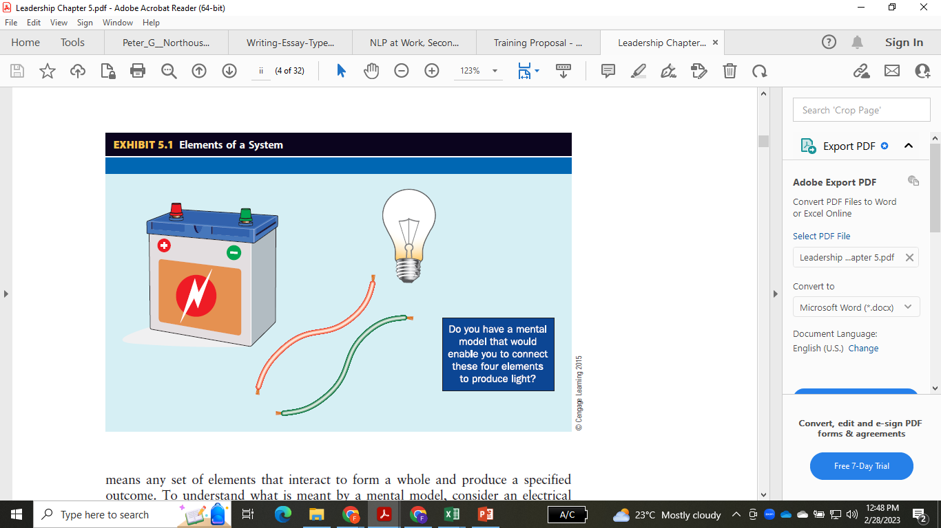
MENTAL MODELS
An internal picture
Mental models are the internal concepts about systems and its elements.
Accurate mental model helps in effective understanding of problems and their effective solution
Important for leadership effectiveness
“You’ll have to give up being an administrator who loves to run others and become a manager who carries water for his people so they can get on with the job.”

Slide 5
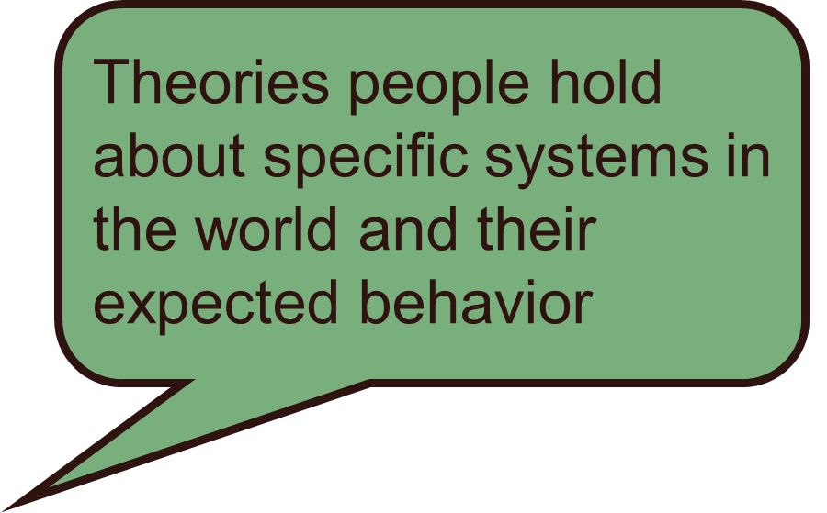
MENTAL MODELS

Slide 6
MENTAL MODELS

Slide 7

LEADER'S ASSUMPTIONS
What difference can assumptions make?
Understanding your assumptions will empower you for better decisions
Temporary rather than fixed truths
Can be long held and flawed
Questioning assumptions can help you understand yourself better and solve problems better

Slide 8
A GLOBAL MINDSET
The ability of managers to appreciate and influence individuals, groups, organizations, and systems that represent different social, cultural, political, institutional, intellectual, or psychological characteristic
Can perceive and respond to many different perspectives at the same time
Multi-cultural engagement
Contextual intelligence is one of the widely shared common factor among top 100 business leaders.

Slide 9
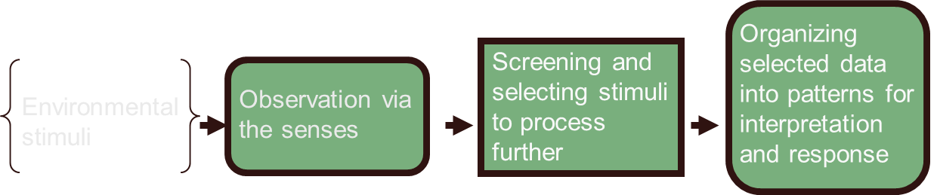
THE PERCEPTION PROCESS

Slide 10

STEREOTYPING
The tendency to assign a person to a group or broad category and then to attribute widely held generalizations about the group to the individual

Slide 11
LEADER'S MIND
Independent thinking
Questioning assumptions and interpreting data and events according to one’s own beliefs, ideas, and thinking, rather than pre-established rules or categories defined by others
Mindfulness
The process of continuously reevaluating previously learned ways of doing things in the context of evolving information and shifting circumstances

Slide 12
LEADER'S MIND
Open-mindedness
expert mind vs. beginner’s mind
Systems thinking
Ability to see and understand the whole system rather than individual elements
Big picture view
Personal mastery
Clarity of mind
Clarity of objectives
Organizing

Slide 13

EMOTIONAL INTELLIGENCE
A person’s abilities to perceive, identify, understand, and successfully manage emotions in self and others

Slide 14
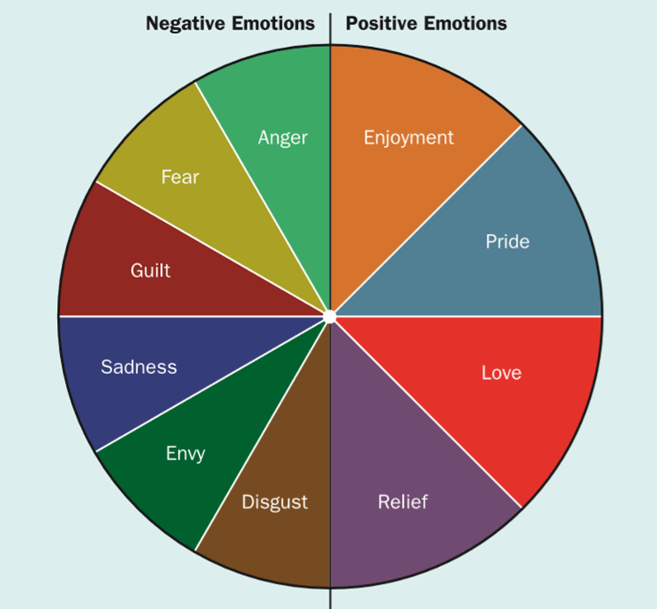
NEGATIVE AND POSITIVE EMOTIONS

Slide 15
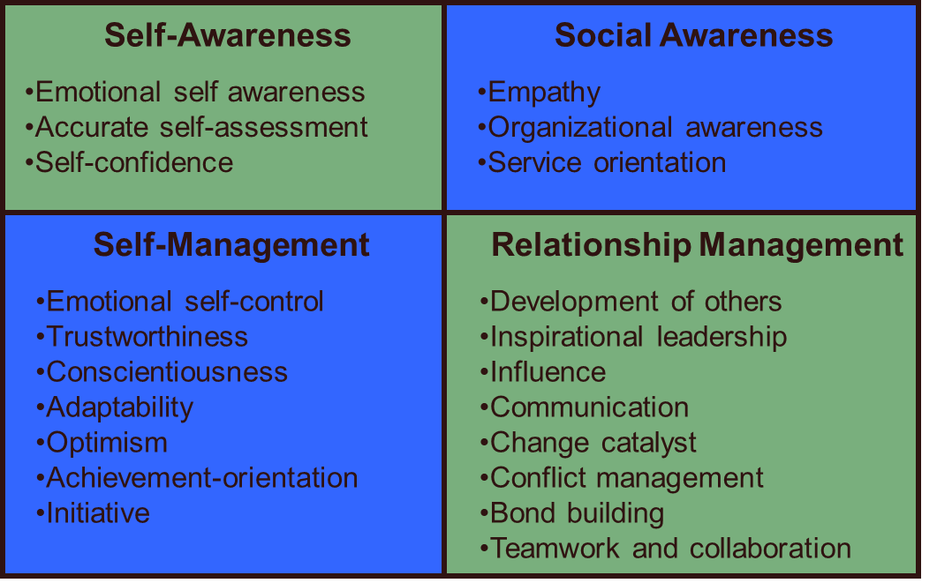
THE COMPONENTS OF EMOTIONAL INTELLIGENCE

Slide 16
TYPES OF MOTIVATION
Fear-based Motivation
Motivation based on fear of losing a job
Love-based Motivation
Motivation based on feeling valued in the job

Slide 17
THAT IS ALL FOR TODAY !!

